Slide 1
Hadoop Data Lake Capacity Requirement
Electric Ireland Data Lake Team

Slide 2
Hadoop Data Lake Current Host Specification
Host | Processor | Cores | Physical Memory | Disk Space
headrhl004s.cld1.tld.int | Intel(R) Xeon(R) CPU E5-2650 v4 @ 2.20GHz | 24 (48 w/ Hyperthreading) | 251.6 GB | 3.8 TB
headrhl005s.cld1.tld.int | Intel(R) Xeon(R) CPU E5-2650 v4 @ 2.20GHz | 24 (48 w/ Hyperthreading) | 251.6 GB | 3.8 TB
headrhl006s.cld1.tld.int | Intel(R) Xeon(R) CPU E5-2650 v4 @ 2.20GHz | 24 (48 w/ Hyperthreading) | 251.6 GB | 3.8 TB
headrhl007s.cld1.tld.int | Intel(R) Xeon(R) CPU E5-2650 v4 @ 2.20GHz | 24 (48 w/ Hyperthreading) | 251.6 GB | 3.8 TB
headrhl008s.cld1.tld.int | Intel(R) Xeon(R) CPU E5-2650 v4 @ 2.20GHz | 24 (48 w/ Hyperthreading) | 251.6 GB | 3.8 TB
headrhl009s.cld1.tld.int | Intel(R) Xeon(R) CPU E5-2650 v4 @ 2.20GHz | 24 (48 w/ Hyperthreading) | 503.6 GB | 43.8 TB
headrhl010s.cld1.tld.int | Intel(R) Xeon(R) CPU E5-2650 v4 @ 2.20GHz | 24 (48 w/ Hyperthreading) | 503.6 GB | 43.8 TB
headrhl011s.cld1.tld.int | Intel(R) Xeon(R) CPU E5-2650 v4 @ 2.20GHz | 24 (48 w/ Hyperthreading) | 503.6 GB | 43.8 TB
headrhl012s.cld1.tld.int | Intel(R) Xeon(R) CPU E5-2650 v4 @ 2.20GHz | 24 (48 w/ Hyperthreading) | 503.6 GB | 43.8 TB

Slide 3
Resource Allocations in yarn
Current Resource Allocation in Yarn
Description | Allocated
Total Number of Yarn Node Managers | 4
Maximum memory allocation available for a container | 1.61 TB
Total CPUs Available to process Yarn Containers | 192 cores
Recommended to use 75% of Total CPUs(as per Cloudera) | 153 Cores
Batch Window | 4 hrs(3:00 AM to 7:00), 4hrs (10:00 to 14:00) & BBS runs hourly
Average number of containers / Project | 145
Current number of projects | 15
Average project runtime | 0.38
Number of Projects running in Parallel | 3

Slide 4
Estimated CPU cores required for the upcoming Projects
Estimated Additional CPU cores required for upcoming projects
Year | Existing Number of Jobs | Number of New projects/jobs | Total Number of Projects | Number of Projects to be run in Parallel | Estimated CPU cores required to process Yarn Containers
2019 | 15 | 10(assumption) | 25 | 4 | 255
2020 | 30 | 10(assumption) | 40 | 5 | 0
To be Resource Allocation
Description | Allocated
Total Number of Yarn Node Managers | 8 (4 existing + 4 New)
Maximum memory allocation available for a container | 3.22 TB
Total CPUs Available to process Yarn Container | 384 Cores
Recommended to use 70% of Total CPUs(as per Cloudera) | 268 Cores
Batch Window | 4 hrs( 3:00 AM to 7:00),4 hrs (10:00 to 14:00) & BBS runs hourly
Average number of containers / Project
Current number of projects
Average project runtime
Number of Projects running in Parallel

Slide 5
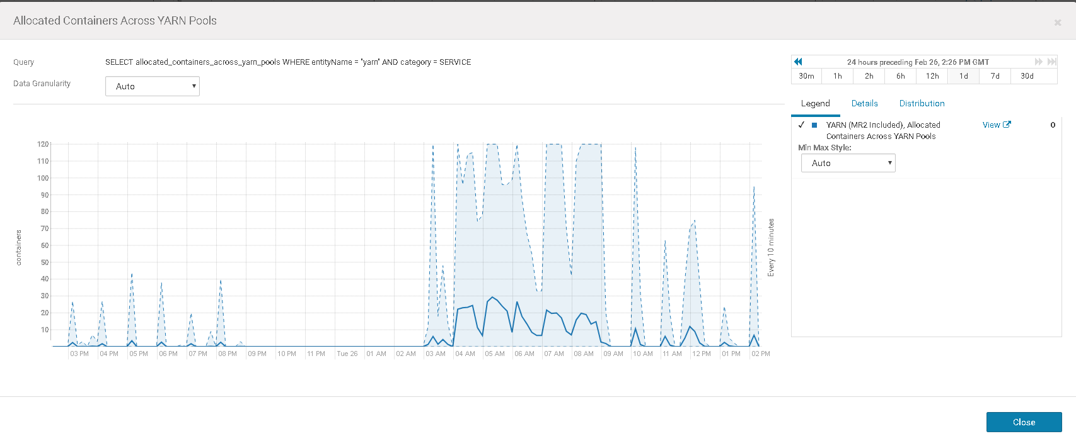
Container usage across Node Manager During Peak Time
The peak time of the batch is between 3:00 AM to 7:00 AM and during this time most of the CPU resources gets allocated. Additional of any new workflows to the batch suite will

Slide 6
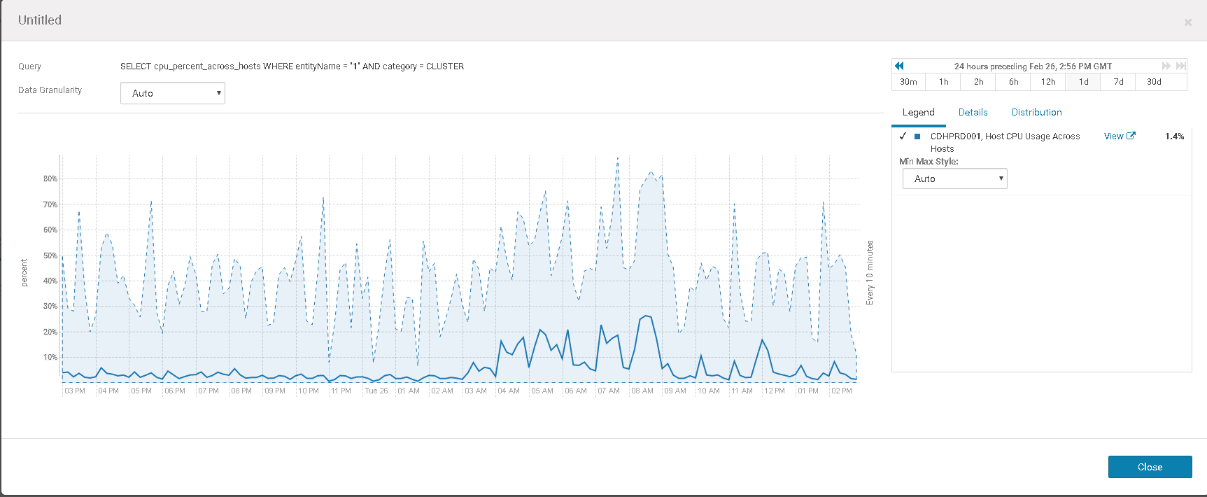
Cluster CPU usage during Peak time

Slide 7
Cluster CPU usage during Peak time
Description | Allocated
Total Number of Yarn Node Managers | 8
Maximum memory allocation available for a container | 1.15 TB
Total CPUs Available to process Yarn Container | 132 cores
Recommended to use 70% of Total CPUs(as per Cloudera) | 92 cores
Batch Window | 6 hrs
Average number of containers / Project | 40
Current number of projects | 25
Average project runtime | 0.75 hrs
Number of Projects running in Parallel | 3
Year | Existing Number of Projects | Number of New projects | Total Number of Projects | Number of Projects to be run in Parallel | Estimated CPU cores required to process Yarn Container
2019 | 25 | 15 | 40 | 5 | 140
2020 | 40 | 6 | 46 | 6 | 161
2021 | 46 | 6 | 52 | 7 | 182

Slide 8
END

